Slide 1
Idea Analysis
Session 4

Slide 2
Elevator pitch
What is your business idea?
How is it differentiated?
What will it take to grow your business?
Why are you the person to do it?

Slide 3
What Did We Learn in the last class?
How to pitch an idea
Whether my idea is attractive to others
What other ideas are out there
How to quickly assess ideas
Who would you like on your team
How to let go of my idea

Slide 4
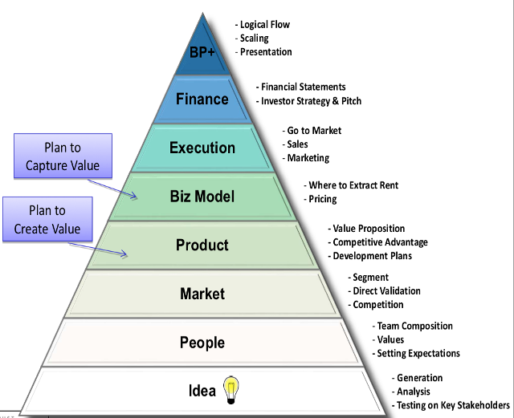

Slide 5
How do you go from an “idea” to a “viable” idea?
1. At first, don’t worry if an idea Is viable
2.Getting the right idea may come from wrong ideas
3. Look for ideas that require as little capital as possible.
4.Look for ideas that will generate some sales quickly
5. Look for ideas where the volume does not have to extraordinary to break even.
6. Look for products where perfect execution is not a requirement

Slide 6
How do you go from an “idea” to a “viable” idea?
7. Look for products/services that are egregiously profitable
8. Look for products and services where the management team does NOT have to be excellent
9.Look for a product where you can identify some quantifiable number of customers
10. Look for a product where the sales and promotion costs are reasonable

Slide 7
11. Look for a product where the buyer does not have all the power
●Example: Selling through Amazon
●Example: Sub-contractor an auto company/ancillary

Slide 8
12. Look for a product that will be attractive to the more intelligent customers
●Avoid selling to dumb customers. There aren’t enough of them
●Example: New power tools based on better battery life

Slide 9
13. Avoid products that appear to be just fads.
●Example: Angry birds (bad)
●Wet suits that can keep divers 5 degrees warmer (good)
●Go-pro cameras (good)

Slide 10
14. Avoid products/services that require a global market
●Cost justify your decision on the local market
●Export is hard, expensive, time consuming and frustrating
●Indian market very cost sensitive, so use for refining product, make money on export
●Apps on google store/apple store automatically are available to customers globally

Slide 11
15. Avoid products that require an OEM for you to succeed, or where some big company has life-or-death control over you
Big company may say No
Margin will be eaten up
You need some self reliance
Ok if it is part, but only part, of plan
Example: Iridium

Slide 12
16. Avoid products that require a change in government policy
Example: Off-shore wind generation
Example: Pollution controls

Slide 13
17. Avoid products that are simply product extensions of a competitor
They will get there before you... with a brand name
Your distribution will leave you
Example-Indian cell phones, TVs, soundbar

Slide 14
18. Avoid products where the lead time to decision making is long ( 6 months +)
Example: Defense products

Slide 15
19. Avoid products where the justification is too soft
Savings are 6 minutes per day per employee

Slide 16
20. Avoid products where the buying decision is too diffuse, or lots of big players all have to line up and cooperate
Example: a Hospital information system
Various banking/bill payment systems that require banks, consumers, and Visa/MC to all buy-in.

Slide 17
21. Avoid products where the market is non-profit organizations
Example: Universities, NGOs

Slide 18
22. Avoid Products where the cost justification cuts across departmental lines
Example: Tech team demanding Nvidea server (Good)
Example:(Bad)
Will save 5% in manufacturing, 10% in engineering, 8% in shipping.
Make the equation reasonable for any department to justify on its own

Slide 19
23. Select products where the benefit can be 400 – 1000% of what they are currently doing
Packaged software
Find metrics that work for the customer
Example: Bookmyshow, IPL, Byju app

Slide 20
24. Avoid Swiss Army Knives
• ... a dive computer that also keeps track of calories and works as a compass.
• .... Product is usually not the best of any

Slide 21
25. Pick products where a trained salesperson can get X sales/year
You want an idea that you can scale
INR 20 lakhs /year/salesman achievable in the second or third year
Enough potential customers
Add enough channels
eg. LinkedIn, WeWork, airbnb

Slide 22
26. Pick products where the user experience is close to his existing behavior
New Products to existing customers
MS Teams to existing MS customers, google meet
Same Products to new types of customer
Nvidea
Avoid: New Products to New Types of Customers

Slide 23
Jeff Bezos List
Obsess over customers
“When given the choice of obsessing over competitors or obsessing over customers, we always obsess over customers.”
Invent
“Any time we have a problem, we never accept either/or thinking. We try to figure out a solution that gets both things.”
Think long term
It’s always day 1
“There’s always more invention in the future. Always more customer innovation. New ways to obsess over customers.”

Slide 24
Summary
You now have general rules to analyze the viability/attractiveness of your ideas
You may have new ones now too.
You have reviewed and ranked your classmates ideas
Top 12 ideas are listed
Darwinian selection process
Finally 6 will survive

Slide 25
Top ideas
80501190001 | 3.59
80501190006 | 3.62
805011900011 | 3.65
805011900013 | 3.7
805011900018 | 3.73
805011900032 | 3.65
805011900036 | 3.68
805011900041 | 3.8
805011900043 | 3.67
805011900051 | 3.75
805011900056 | 3.66
80501190001 | 3.59

Slide 26
Where Do We Go From Here?
Hopefully you are starting to zero in on an idea and a team
Now focus on the team
The idea will morph over time and potentially completely change
Next class we will review the status of the teams
Those who are not on a team or have last second remorse will have 2 days to find or create a team. Please let me know so that I can make changes in the groups on MS Teams
Next class will also talk about some thoughts about what to do once you think you have a team

Slide 27
This is an academic exercise with the focus on learning the process – there are no commitments beyond this semester ... but to find a good team will make the experience much better and it might be someone you want to work with longer term

Slide 28
